Slide 1
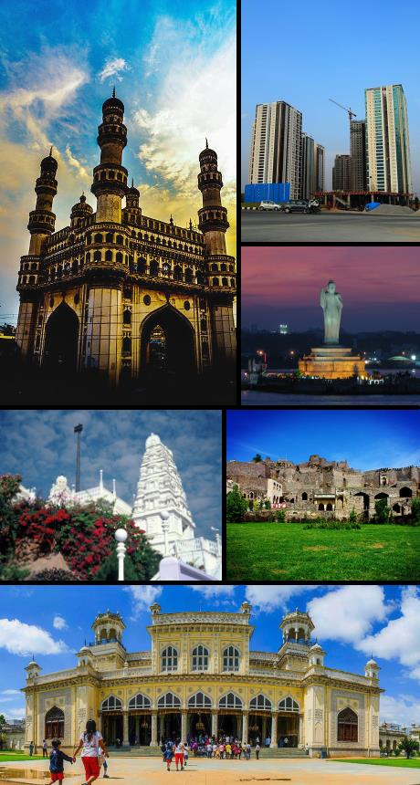
Hyderabad
Recommendation system for new Restaurants
Capstone Project

Slide 2
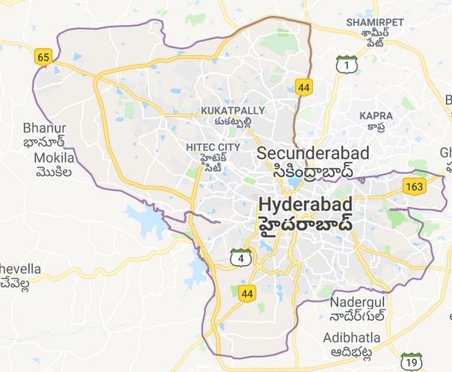
Know Your City
Hyderabad is the capital of the Indian state of Telangana and de jure capital of Andhra Pradesh. Occupying 650 square kilometres along the banks of the Musi River, Hyderabad City has a population of about 6.9 million and about 9.7 million in Hyderabad Metropolitan Region, making it the fourth-most populous city and sixth-most populous urban agglomeration in India. At an average altitude of 542 metres, much of Hyderabad is situated on hilly terrain around artificial lakes, including Hussain Sagar—predating the city's founding—north of the city centre.

Slide 3
Introduction
This recommendation system enable the Restaurant managers in Hyderabad to explore the Hyderabad area to see what kind of venues exist and what kind of restaurants will be suitable for the neighborhood. Transportation service providers would like to see which areas in Hyderabad would need time crucial transportation services especially perishables. Residents of Hyderabad would like to know about the kind or restaurants available in Hyderabad and know where specialty restaurants are available. Residents of Hyderabad would like to see the most common venues in their area

Slide 4
Business problem
Restaurant contractors specialize in managing the supply chain for restaurants in consumables like groceries, bakery items, fruits, dairy products and other consumables.
Contractors in Hyderabad would like to see which areas in Hyderabad have high revenue potential
The objective is to explore the areas in Hyderabad holding huge earning potential where their services could be used to full extent
The contractors would also like to focus on the South of Hyderabad and examine areas in and around the neighborhood of South of Hyderabad which provides more service opportunities.
The contractors want to build a storage unit for the groceries they buy from villagers and farmers inside the borough and also reduce the transportation costs for the Restaurant owners with Transportation logistic services

Slide 5
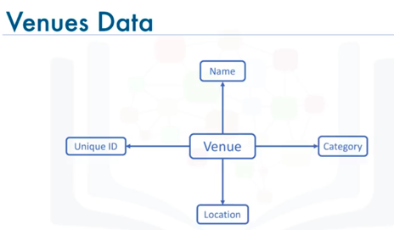
DATA Description
Demographic data was collected from
https://mygov.in
CSV file of the neighborhoods using the Geocoder package, having geographical coordinates of each postal code: http://cocl.us/Geospatial_data
https://api.foursquare.com api is used to
get Location details like venues

Slide 6
methodology
Scripting Language - Python (Python 3x)
IDE - https://labs.cognitiveclass.ai/tools/jupyterlab
Packages used
- BeautifulSoup package for web scraping
- Sklearn for forming neighborhood clusters based on venue categories using unsupervised k-means clustering algorithm
Data Cleaning
Data Filtering
Data Transformation
Data Visualization and Analysis
Clustering
Python packages used
Pandas - Library for Data Analysis
NumPy – Library to handle data in a vectorized manner
JSON – Library to handle JSON files
Geopy – To retrieve Location Data
Requests – Library to handle http requests
Matplotlib – Python Plotting Module
Sklearn – Python machine learning Library
Folium – Map rendering Library

Slide 7
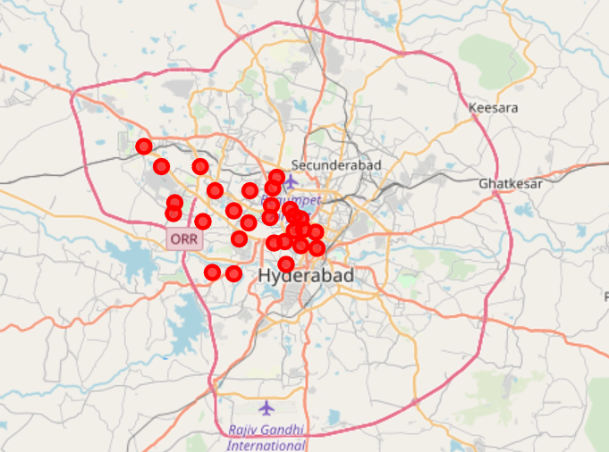
Neighborhood

Slide 8
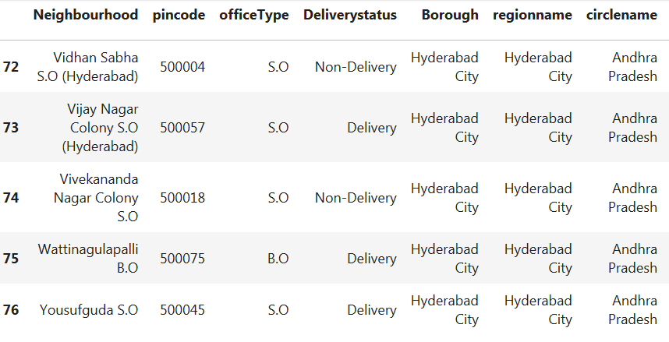
Hyderabad – Boroughs with postal codes *Representative sample

Slide 9
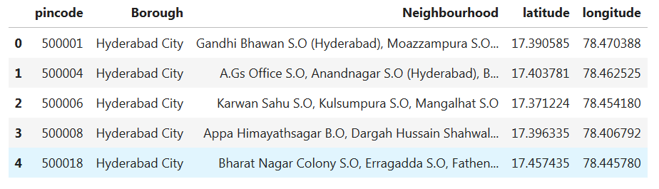
Hyderabad neighborhood with Latitude & Longitude information

Slide 10
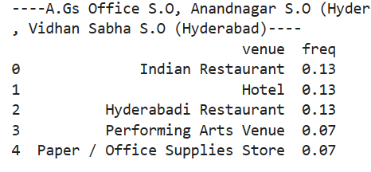
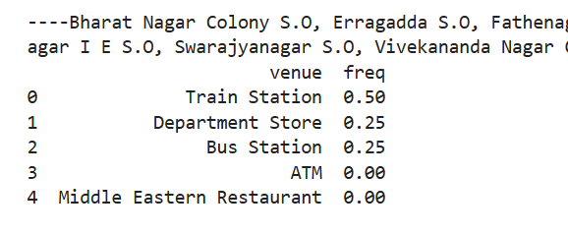
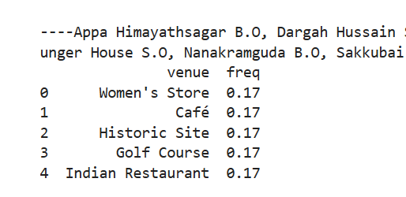
Neighborhood with venue details

Slide 11
Neighborhood recommendations
Below are the areas where the number of restaurants are the highest hence having potential for higher revenues for Restaurant operational service support
A.Gs Office S.O
Anandnagar S.O (Hyderabad),
Bazarghat S.O (Hyderabad)
Khairatabad H.O
Parishram Bhawan S.O
Vidhan Sabha S.O (Hyderabad).
And the most common venues are Hyderabadi Restaurants
In majority of part of Hyderabad City "Women's Store" & "Food Court" is the most popular type of service.

Slide 12
THANK YOU

